Slide 1

Short-Term load Forecasting
-Gagandeep KN (181IT215)
-Atharv R (181IT208)
-Prithvi R Patil (181IT234)

Slide 2
LOAD FORECASTING:
Forecasting in the problem of determining the future values of a time series from the current and past values.
Load forecasting is about estimating future consumptions based on various data and information available as per consumer behaviour.
Short-term Load Forecasting can help to estimate the load flows and to make decisions that can prevent overloading. Timely implementations of such decisions lead to improvement of network reliability and to reduced occurrences of equipment failures or blackout.

Slide 3
Role of load forecasting:
For proper planning of Power System.
To determine the potential need for additional new generating facilities.
To determine the size of the plants.
On correct values of demand, load forecasting will prevent over designing of conductor sizes.
For proper planning of Transmission and Distribution facilities.
Wastage due to unplanning like the purchase of equipment which is not immediately required can be avoided.
For proper Financing.
For proper Grid Formation.

Slide 4
Load Curves:
Variations in load on power station from time to time.
Daily load curves.
Monthly load curves.
Annual load curves.
Load curves give –
Variation of load during different times.
Total no. of units generated.
Maximum demand.
Average load on a power station.
Load Factor.

Slide 5
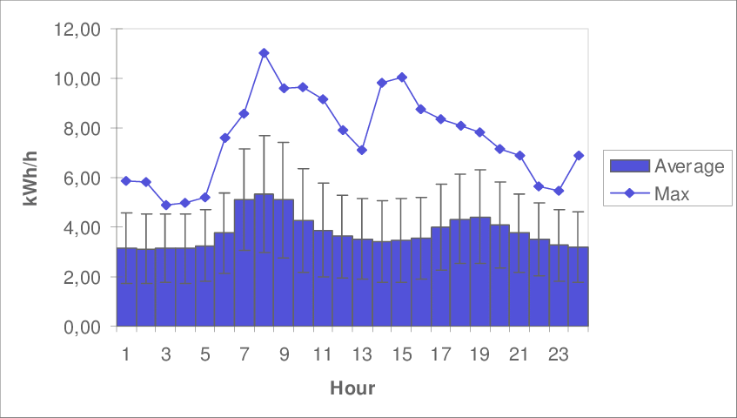
Daily Load Curve sample:

Slide 6
Factors affecting Load Forecasting:
Hours of the day (day/night).
Days of the week (weekday/ weekend).
Time of the year (season).
Weather conditions (Temperature and Humidity).
Class of customers (residential, commercial, industrial, agricultural, public, etc).
Special Events (public holidays, etc).
Electricity price.

Slide 7

Data ?

Slide 8
Data Used:
We have used ENTSO-E Power Statistics’s Data which can be found at https://www.entsoe.eu/data/power-stats/
We have collected corresponding weather data from NCEI ISD (https://www.ncdc.noaa.gov/isd/data-access)
Features Used
Time of the day.
Day of the week.
ENTSO-E Hourly Load
Weather condition

Slide 9
Data processing:
Defining a function to convert a vector of time series into a 2D matrix
split dataset: 90% for training and 10% for testing
shuffle the training set (but do not shuffle the test set)

Slide 10
Implemented Algorithms

Slide 11
Non-Traditional Algorithms:
Implemented:
K-means Clustering
Auto Regressive Integrated Moving Average (ARIMA)
Long Short Term Memory(LSTM)
Support Vector Regression (SVR)
Deep Belief Network (DBN)

Slide 12
K-means clustering
K-means clustering is one of the simplest and popular unsupervised machine learning algorithms.
Typically, unsupervised algorithms make inferences from datasets using only input vectors without referring to known, or labelled, outcomes.
To process the learning data, the K-means algorithm in data mining starts with a first group of randomly selected centroids, which are used as the beginning points for every cluster, and then performs iterative (repetitive) calculations to optimize the positions of the centroids

Slide 13
K-means clustering
It halts creating and optimizing clusters when either:
The centroids have stabilized — there is no change in their values because the clustering has been successful.
The defined number of iterations has been achieved.
Issues with K-means clustering:
Its performance is usually not as competitive as those of the other sophisticated clustering techniques because slight variations in the data could lead to high variance.

Slide 14
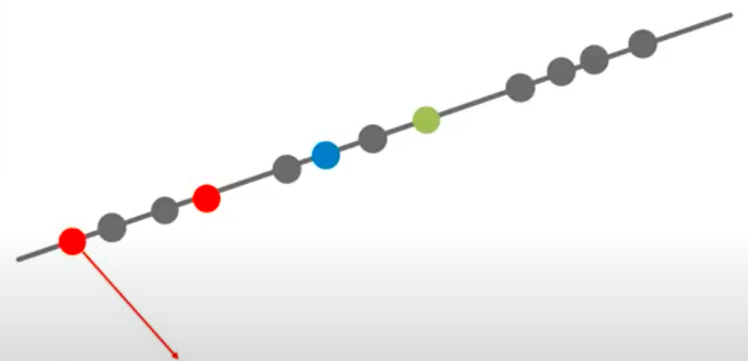
K-means clustering
step 1: select the number of clusters to be identified, i.e select a value for K=3 in this case
step 2: Randomly select 3 distinct data point
step 3: Measure the distance between the 1st point and selected 3 clusters
Step 4: Assign the first point to the nearest cluster

Slide 15
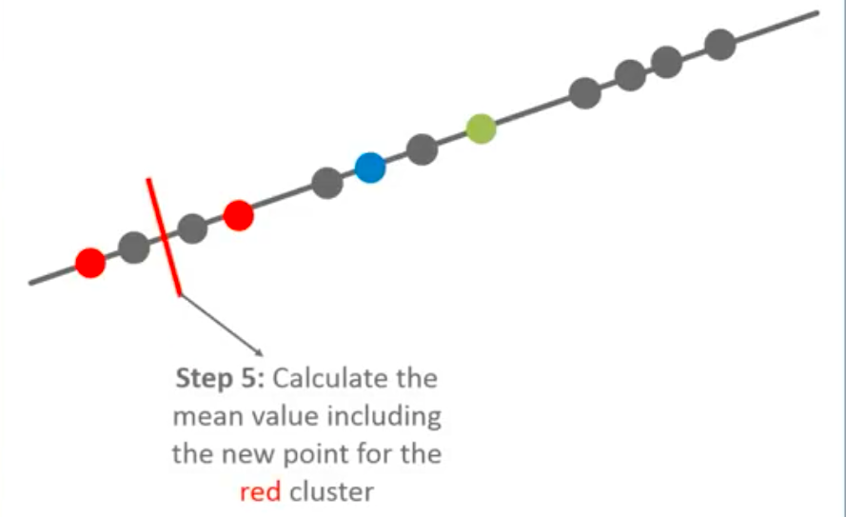

Slide 16
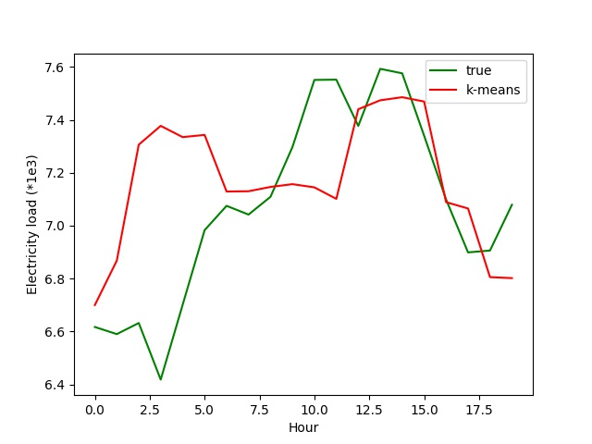
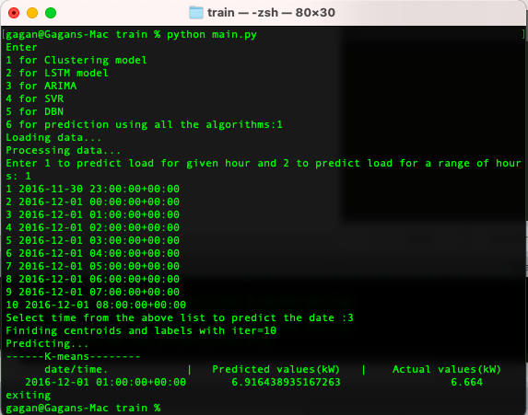
K-means clustering output

Slide 17

Auto Regressive Integrated Moving Average (ARIMA)
An ARMA(p, q) model is a combination of AR(p) and MA(q) models and is suitable for univariate time series modelling.
However the ARMA model can only be implemented on stationary data. Non-stationary data often shows trend or seasonality or both in its waveform.
Since our load data has both trend and seasonality we implemented ARIMA on our data.

Slide 18

Auto Regressive Integrated Moving Average (ARIMA)
The mathematical formulation of the ARIMA model using lag polynomials is given below.
The ARIMA model is for non-seasonal non-stationary data.
For the case of seasonal data we use Seasonal ARIMA. In this model seasonal differencing of appropriate order is used to remove non-stationarity from the series.

Slide 19
Auto Regressive Integrated Moving Average (ARIMA)

Slide 20
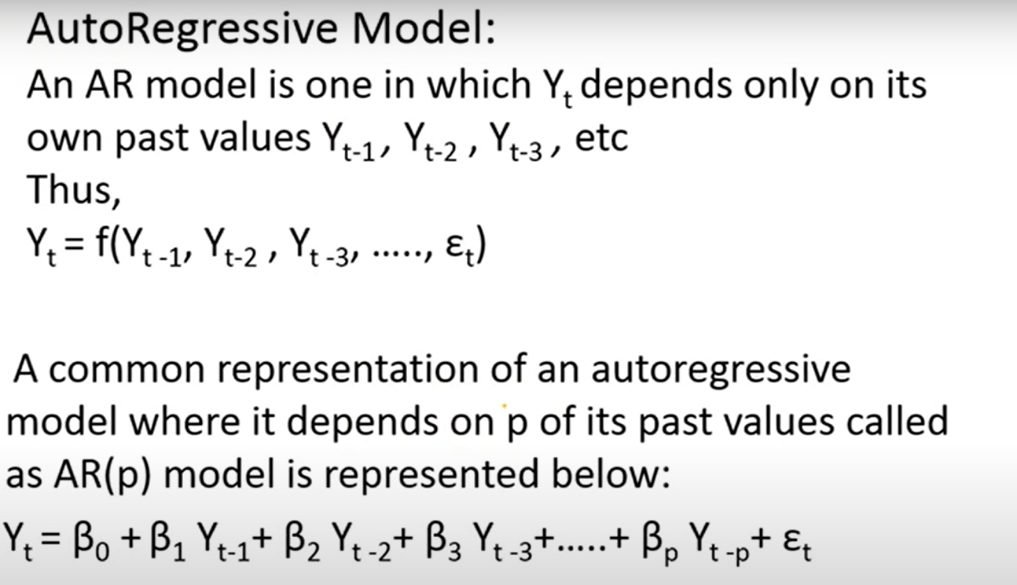
Auto Regressive Integrated Moving Average (ARIMA)

Slide 21
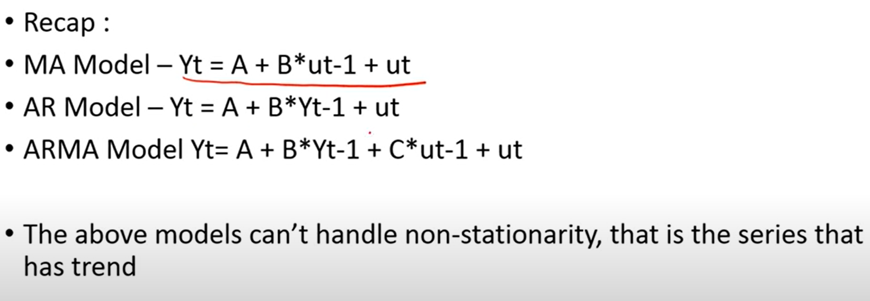
Auto Regressive Integrated Moving Average (ARIMA)

Slide 22
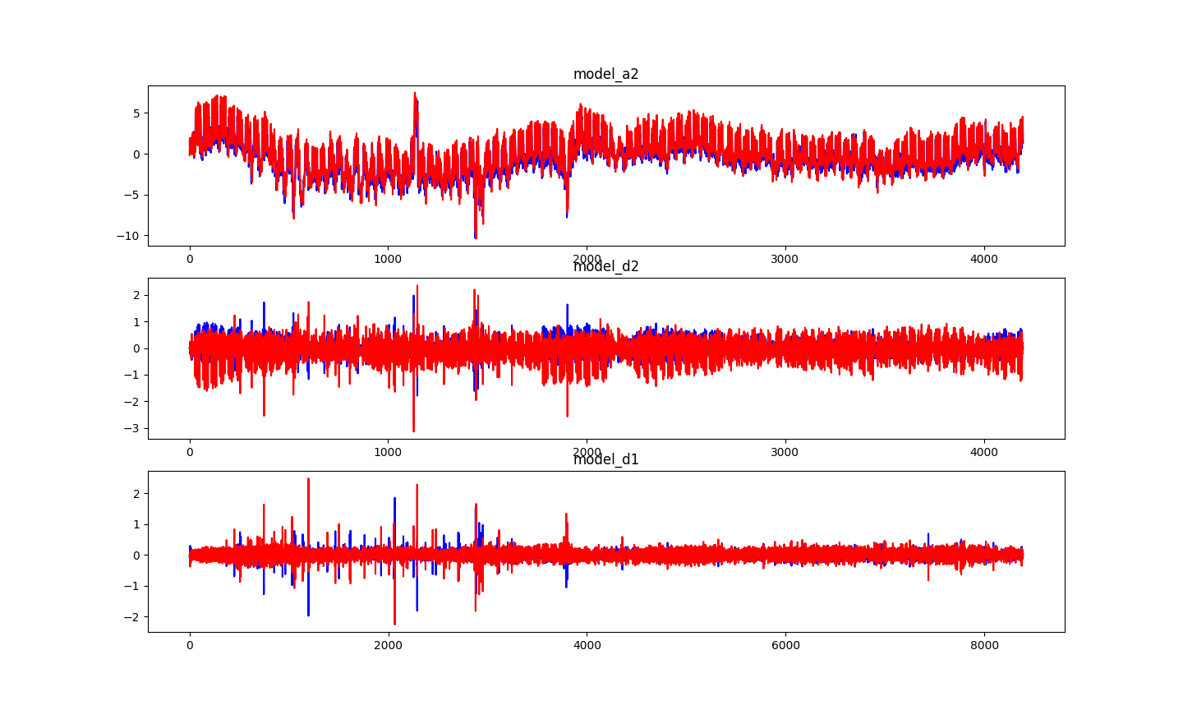
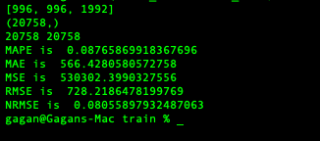
ARIMA output:

Slide 23
Long Short Term Memory (LSTM):
These networks are an extension for recurrent neural networks, which basically extends their memory.
LSTMs enable RNNs to remember their inputs over a long period of time as contain their information in a memory.
This memory can be seen as a gated cell, where gated means that the cell decides whether or not to store or delete information (e.g. if it opens the gates or not), based on the importance it assigns to the information.

Slide 24

In an LSTM you have three gates: input, forget and output gate.
These gates determine whether to let new input in (input gate), delete the information because it isn’t important (forget gate) or to let it impact the output at the current time step (output gate).

Slide 25
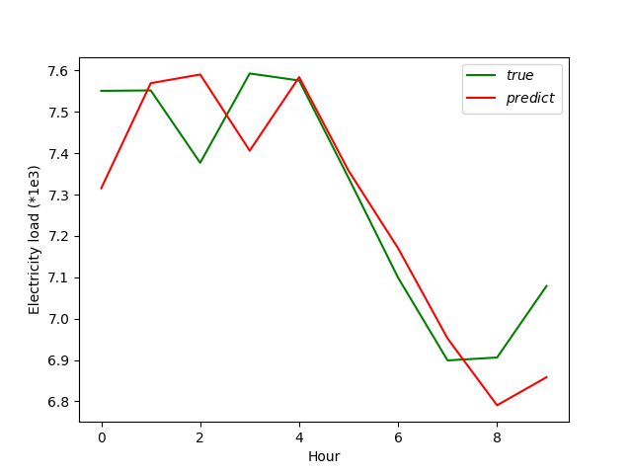
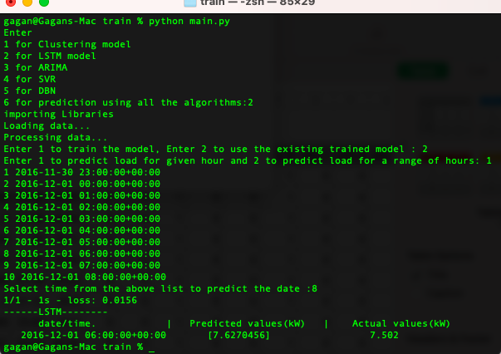
LSTM output:

Slide 26
Feed forward Neural Network:
These networks can be trained with sequential data by giving the time stamp and other dependencies such as weather data at that time as input.
They have no memory of the input they received previously and are therefore bad in predicting what’s coming next.
They simply can’t remember anything about what happened in the past, except their training.
Based on the above constraints, it is evident that the model overfits and gives a bad prediction.

Slide 27
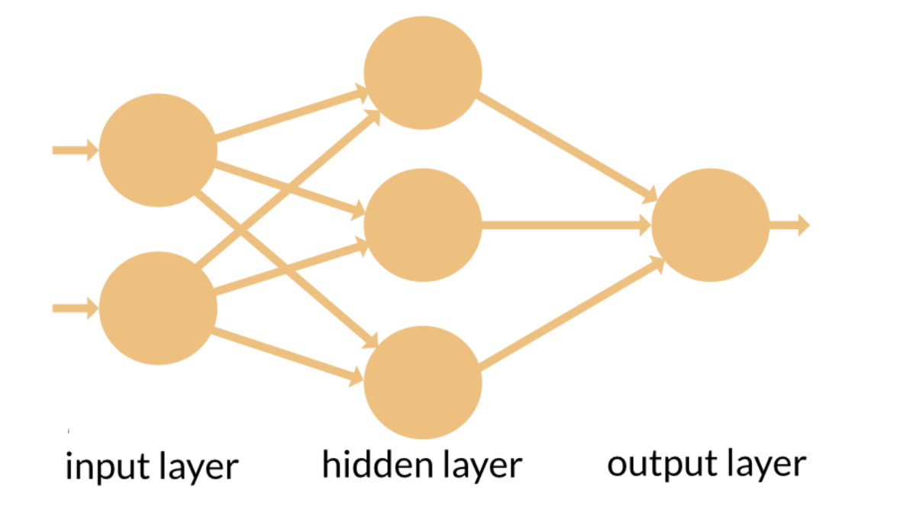
Feed forward Neural Network:
Time stamp
Weather data

Slide 28
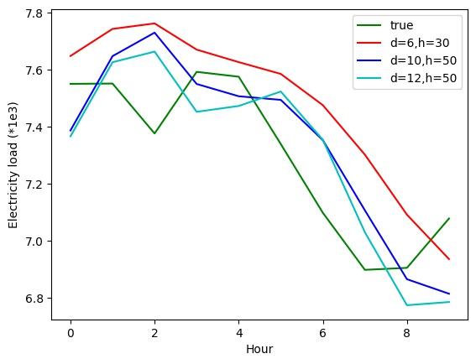
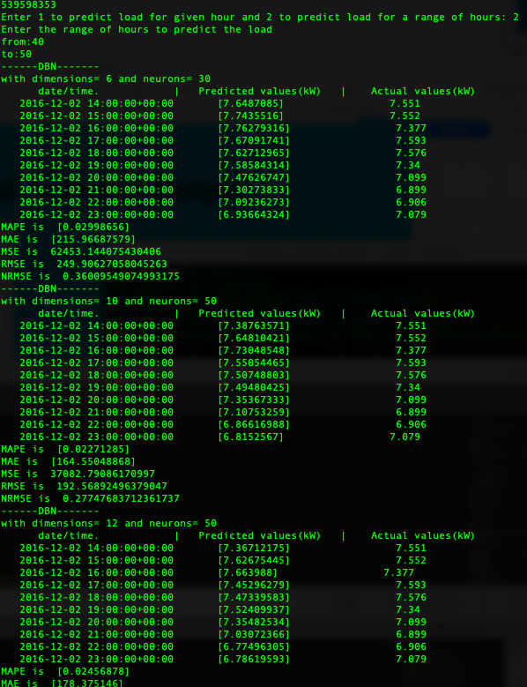
Feed forward Neural Network Output

Slide 29
Support Vector Regression (SVR):
Support Vector Machines (SVMs) are well known in classification problems. The use of SVMs in regression is not as well documented, however. These types of models are known as Support Vector Regression (SVR).
Support Vector Regression (SVR) uses the same principle as SVM, but for regression problems
SVR gives us the flexibility to define how much error is acceptable in our model and will find an appropriate line (or hyperplane in higher dimensions) to fit the data.

Slide 30
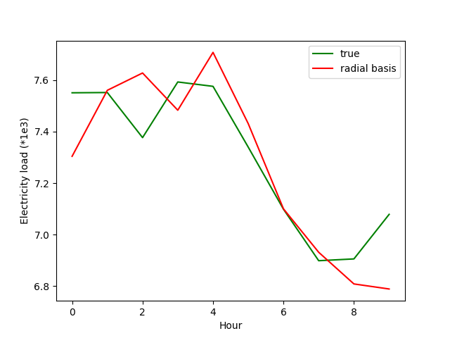
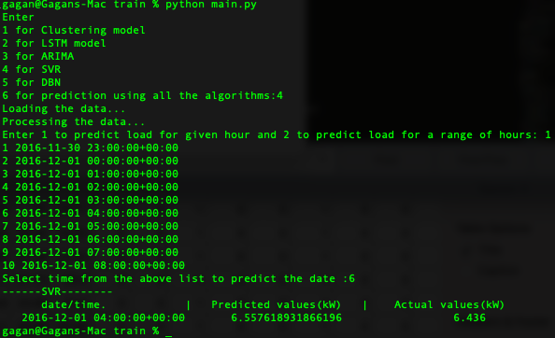
SVR output:

Slide 31
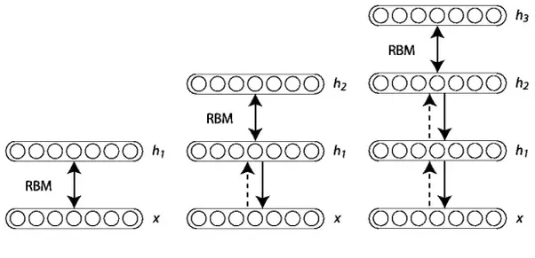
Deep Belief Network (DBN):
Deep Belief Networks are a graphical representation which are essentially generative in nature i.e. it produces all possible values which can be generated for the case at hand. It is an amalgamation of probability and statistics with machine learning and neural networks. Deep Belief Networks consist of multiple layers with values, wherein there is a relation between the layers but not the values. The main aim is to help the system classify the data into different categories.

Slide 32
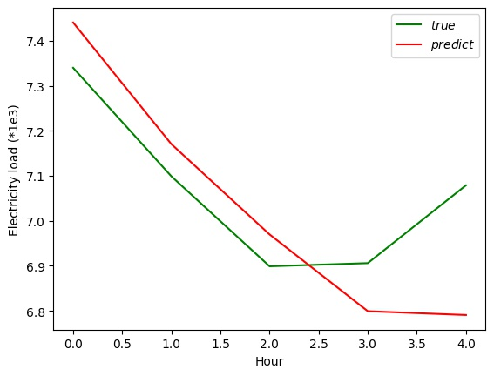
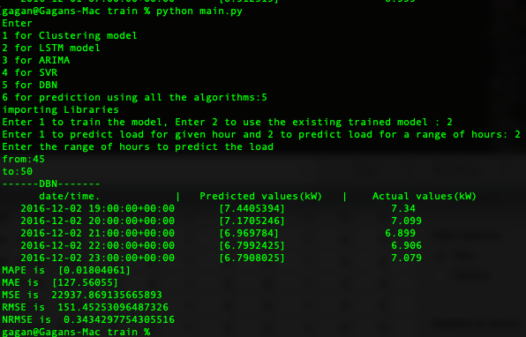
Deep Belief Network (DBN) Output:

Slide 33
Literature survey
C. Liu, Z. Jin, J. Gu and C. Qiu, "Short-term load forecasting using a long short-term memory network," 2017 IEEE PES Innovative Smart Grid Technologies Conference Europe (ISGT-Europe), Turin, Italy, 2017, pp. 1-6, doi: 10.1109/ISGTEurope.2017.8260110.
Short-term load forecasting using lifting scheme and ARIMA models
Author links open overlay panel
Cheng-MingLeeaChia-NanKob

